Slide 1


THRIVING ONLINE IN THE WORKPLACE
28 SEPTEMBER 2020
-JOSHUA MURRAY -KENTARO ENOKIDA
-MARIYAM ARIEF -TAKEKAZU KITAGISHI

Slide 2


Talking – A Nuisance
Image Credit: https://indowwindows.com/resources/blog/noise-pollution-solutions/

Slide 3
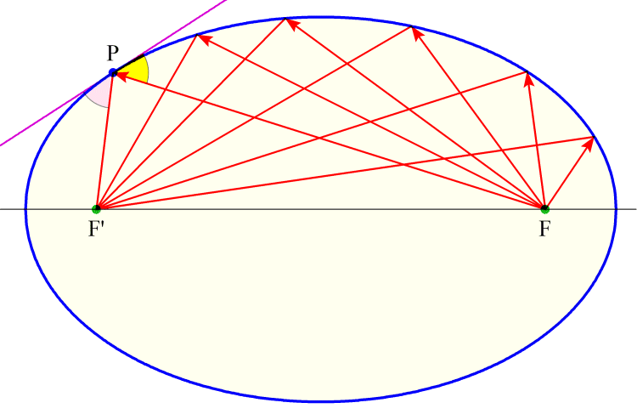

Imagine the Combination...
+
Elliptical reflection of waves to focal points
Food service plastic masks
Image Credit: https://tomodak.com/paper/q_ref.html
Image Credit: https://www.younggenerationshop.com/products/kitchen-face-mask

Slide 4
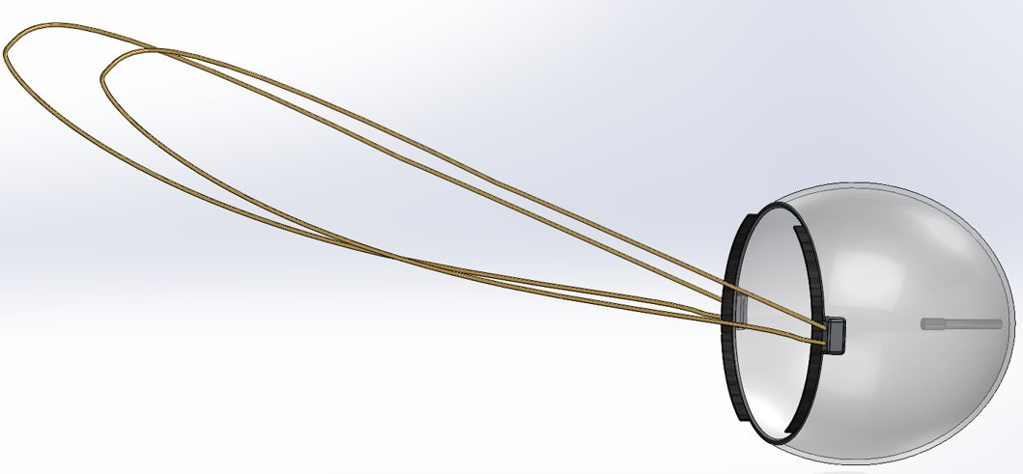
Chatterbox
Transparent plastic elliptical case
Soft Face Protector
Elastic Straps
Microphone (Positioned at focal point)
Air Inlet/ Outlet

Slide 5

We Appreciate Your Vote!
CHATTERBOX

